Slide 1

File Storage Indexing
Hariom Vyas
Notes:
Good Evening Everyone,
My name is Hariom Vyas. Today I am going to show you a sneak peak into the future. How a simple feature can become so powerful and useful foe everyday use.

Slide 2

Necessity is mother of Invention.
Updation of technology has become a must thing in Industry. Today’s latest becomes tomorrow’s vintage.
Notes:
Necessity is the mother of invention. Most of the technology that you see around you was developed out of necessity. Laptops, Websites, Powerpoint, Excel, Notepad. Operating System and many more. In my Undergrad I had an idea of creating a centraliced system where everything was connected to a central system. I called it NWS. I know it sounds like AWS but its different.

Slide 3

Nimbus Web Server
Notes:
NWS stands for Nimbus Web Server.

Slide 4



Notes:
The name Nimbus came from one of my favourite Anime DragonBall, Sun Wukong or Monkey King had a cloud which he would summon for mobility. And If you are a Harry Potter Fan, you may know Nimbus 2000. Everyone dreamed of flying on it on quidditch game when Harry Potter first came out.

Slide 5
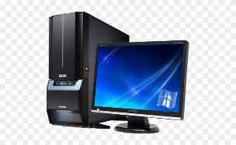


NIMBUS Web Server
Notes:
So how it works, Each and very device is connected to Nimbus Web Server. The next photo you take, or file that gets created in your system or phone gets automatically transferred to NWS and you can access it from anywhere, anytime. Awesome Right?

Slide 6
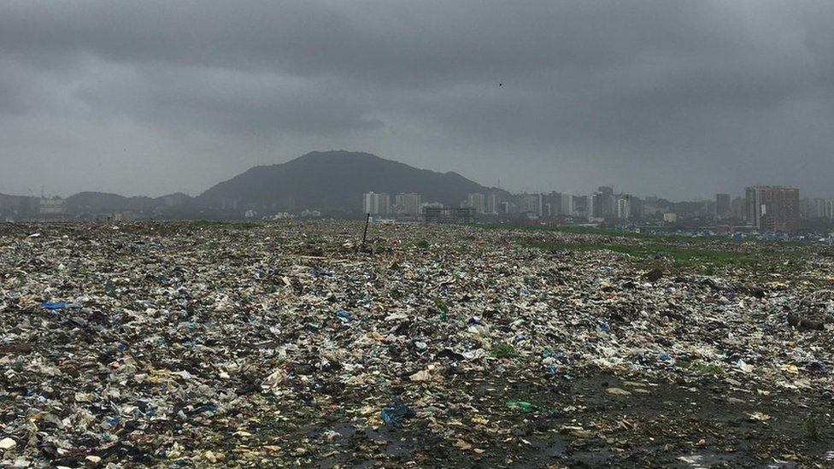
Your File is here somewhere
Notes:
But when all of your files are at one place and you have thousands or even million of files when you are an organization, it becomes hard to find a single file that you need from a thousand and millions of files. So Whats the solution?

Slide 7

Search Engine for Files
Notes:
Search Engine For Files. Does it sound similar to something?

Slide 8
What’s the Use?
Faster Retrievals
Literally searching in Different File Formats
Notes:
Okay, So You have multiple needs right now. I want to search through files and faster. Now I have thousands or even million of files, each of them are important so I keep them all and together at same place, When I say files, It can have any format PDF, word, MP4, MP3, python or notebooks, I want to retrieve them faster and when I say I want to retrieve a PDF it should not popup cat GIFs. Does it sound similar?

Slide 9
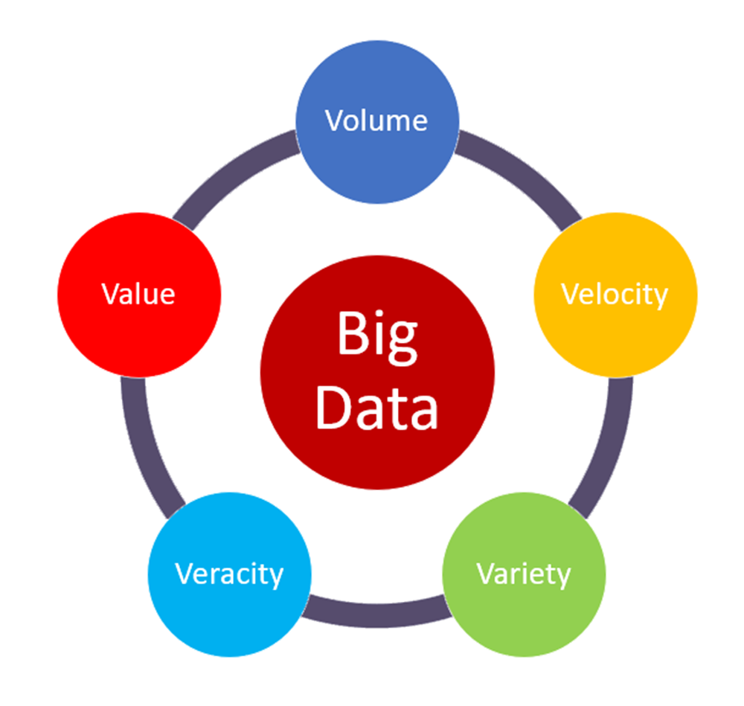
Notes:
Look at this.

Slide 10
Tools Used
Google Colab as IDE
Google Drive as Storage
PYSpark
Notes:
Now for this project, I have used Google Colab as my IDE. Google Drive as a Storage. I have uploaded all of my files to Google Drive and I am using Pyspark for data processing.

Slide 11
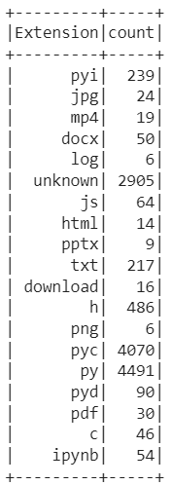
Dataset Insights
Storage - 2.8 GB (As of 12/06/2022)
File Formats – pyi, jpg, mp4, docx, log, js, html, pptx, txt, download, h, png, pyc, py, pyd, pdf, c, ipynb and unknown.
Notes:
Now the Data Storage Size was 2.8 GB when I submitted this project. It contained all of the files I have created in the last two semesters. There were multiple file formats in it. List can be seen over here.

Slide 12





Project Flow
Google Drive
CSV/Database
Index Creator
Data Pre-processing
Data Extraction
Final Data
Notes:
This is the Project Flow.

Slide 13
Why Google Colab?
Sharing
Versioning
Easy to mount Google Drive
Faster and better than other ODE
Available on Cloud (Anytime Anywhere)

Slide 14
PySpark
Spark 3.3.1
Hadoop3.2
Scala 2.13

Slide 15
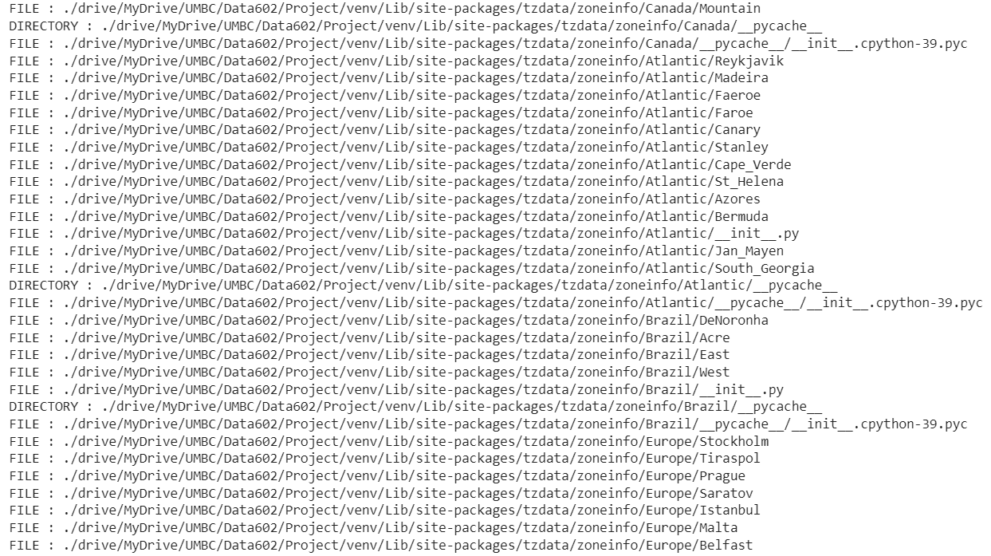

Slide 16
Metadata Information
st_mode - It represents file type and file mode bits (permissions).
st_ino - It represents the inode number on Unix and the file index on Windows platform.
st_dev - It represents the identifier of the device on which this file resides.
st_nlink - It represents the number of hard links.
st_uid - It represents the user identifier of the file owner.
st_gid - It represents the group identifier of the file owner.
st_size - It represents the size of the file in bytes.
st_atime - It represents the time of most recent access. It is expressed in seconds.
st_mtime - It represents the time of most recent content modification. It is expressed in seconds.
st_ctime - It represents the time of most recent metadata change on Unix and creation time on Windows. It is expressed in seconds.

Slide 17
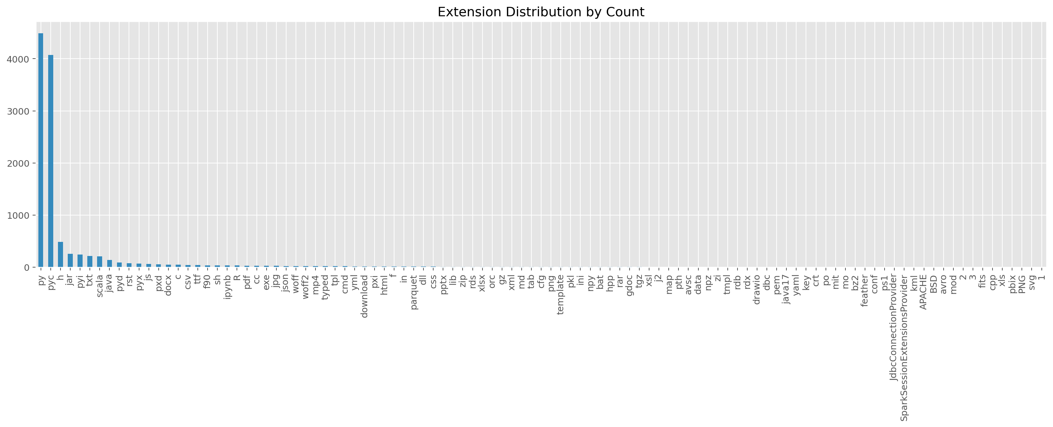
File Distribution by Count

Slide 18
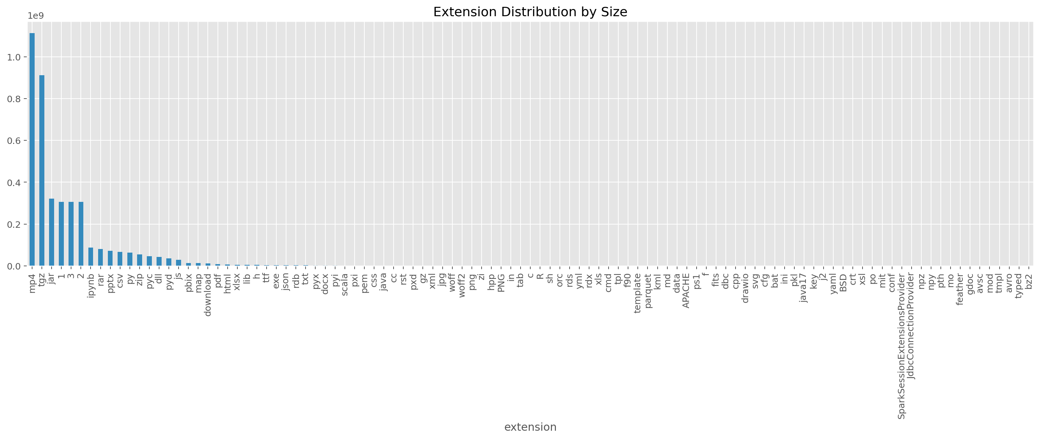
File Distribution by Size

Slide 19
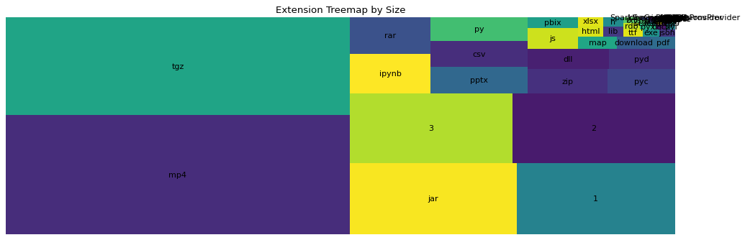
Extension Treemap

Slide 20
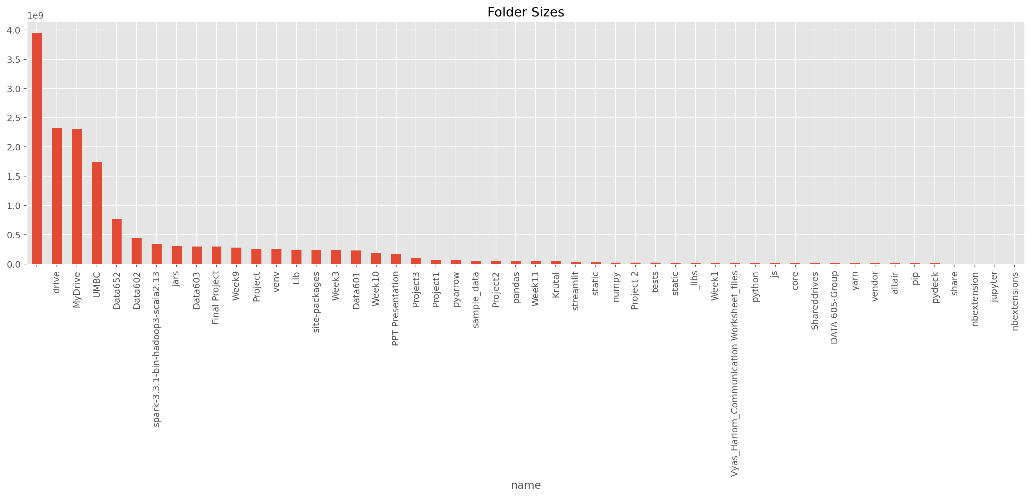
Folder Distribution by Size

Slide 21
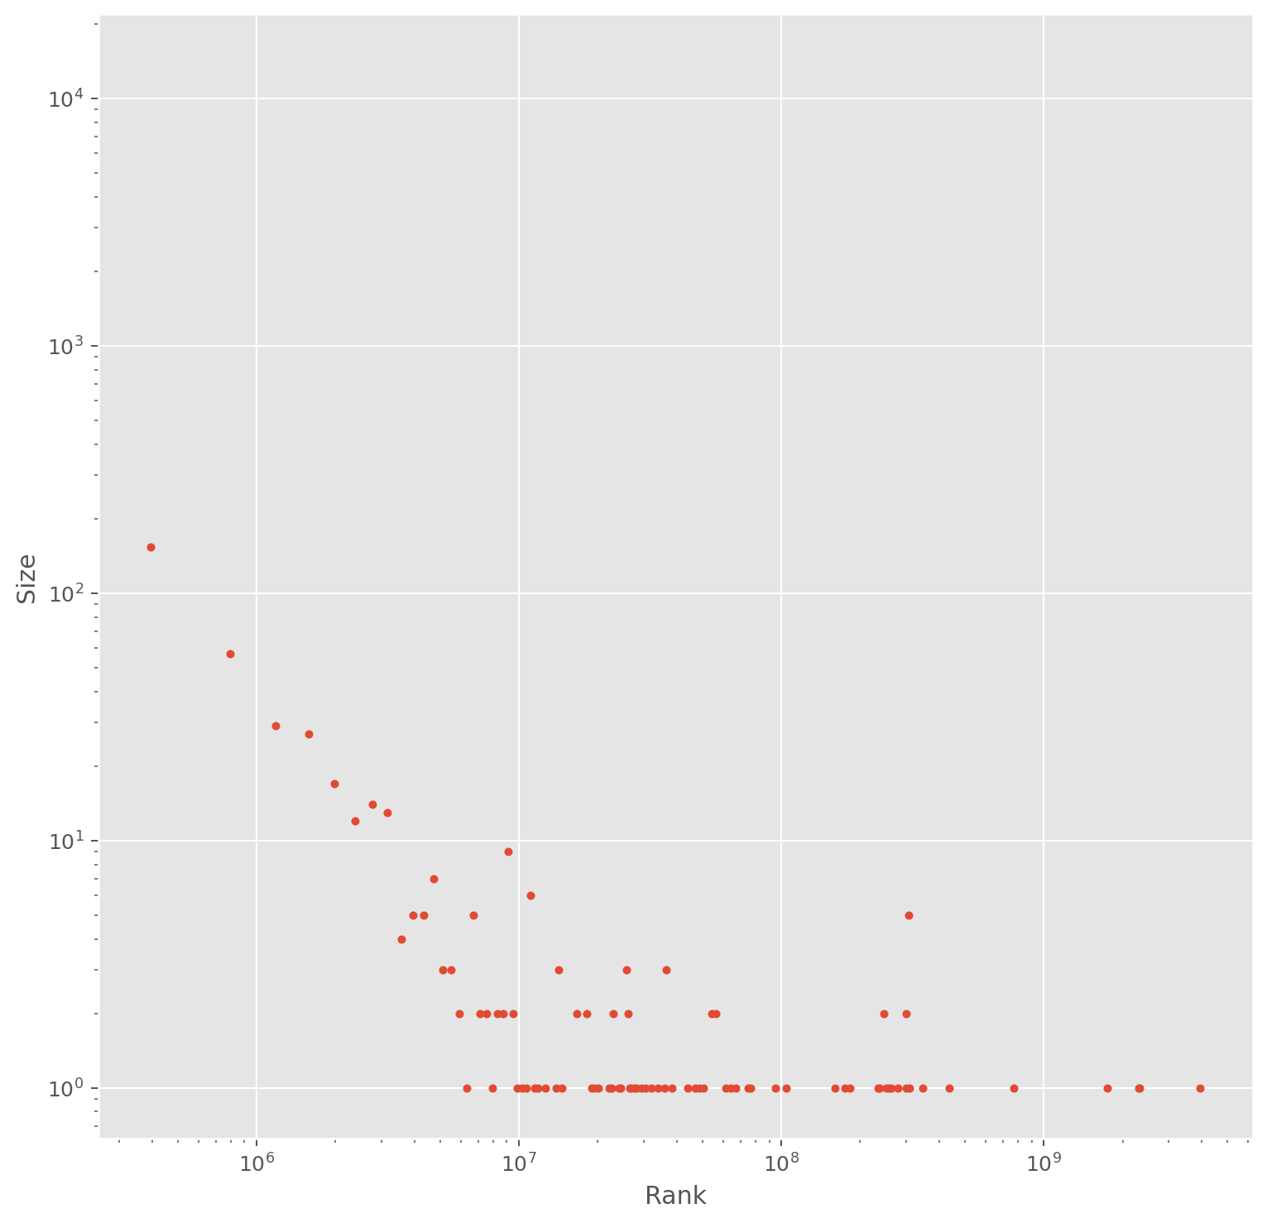
Log-Scale based on Size and Rank

Slide 22
Data Pre-processing & Insights
Null Values
Changing Datatypes
Row Counts
Summary (Count, Mean, Stddev, Min, 25%, 50%, 75%, Max)
Describe (Count, Mean, Stddev, Min, Max)

Slide 23
Functions to Extract Data
Text
Docx
PDF
Python

Slide 24

User Defined Functions
Created User Defined Functions with our logic code
Registered them as UDFs in Spark

Slide 25
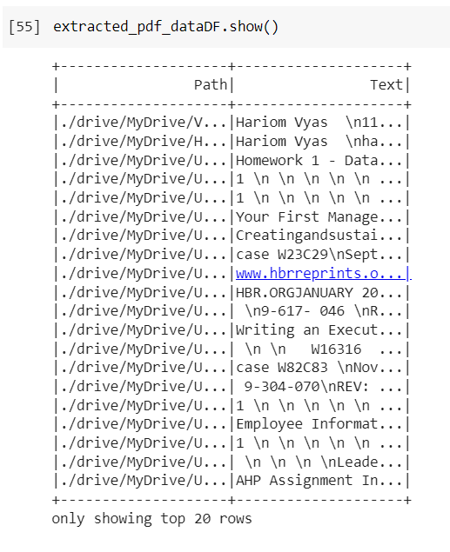
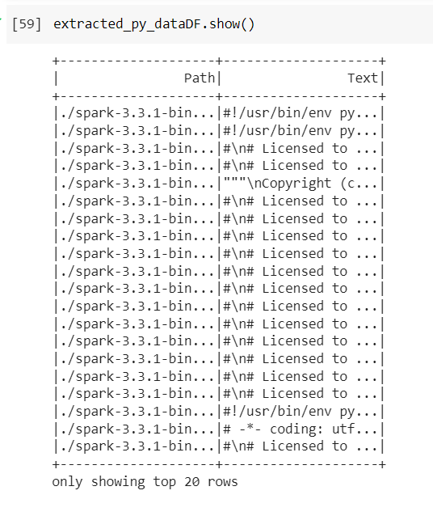
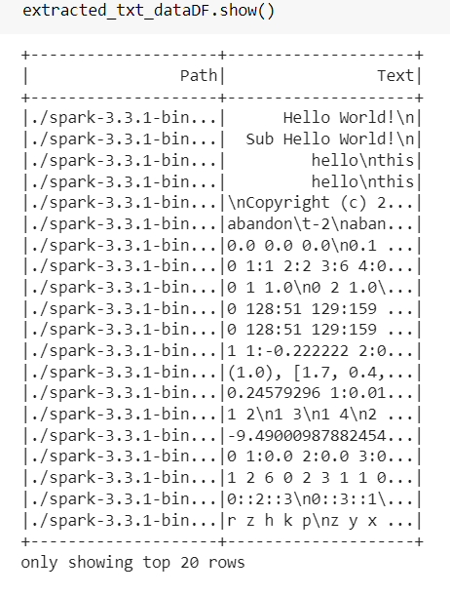
Outputs of UDF
PDF
Python
Text

Slide 26

This is not One time.

Slide 27


Creating a Pipeline to get Updated Indexes
Google Drive
Index Updater
Updated Index DataFrame
CSV/Database
Index Creator
Data Pre-processing
Data Extraction
Final Data

Slide 28
Why Big Data?
Going Over Thousands files (12827 in our Case)
Multiple File Formats (Text, Docx, PDF, Image, Python)
Creating Indexes as fast as files get created
Extracting only specific information

Slide 29
Use cases
Accounting Firms
Bookkeeping
Architecture Firms
Contracting Companies
Lawyers
Fine Print
Search Engine for File System

Slide 30

Future Scope?

Slide 31

THANK YOU
This Photo by Unknown Author is licensed under CC BY-SA

